Slide 1
Weathering
Chapter
7
Learning outcomes: 1.3

Slide 2
At the end of this chapter, you will be able to:
7.1 Explain the differences between denudation, weathering and erosion.
7.2 Identify the three types of weathering.
7.3 Explain how mechanical weathering affects the landscape.
7.4 Explain how chemical weathering affects the landscape.

Slide 3
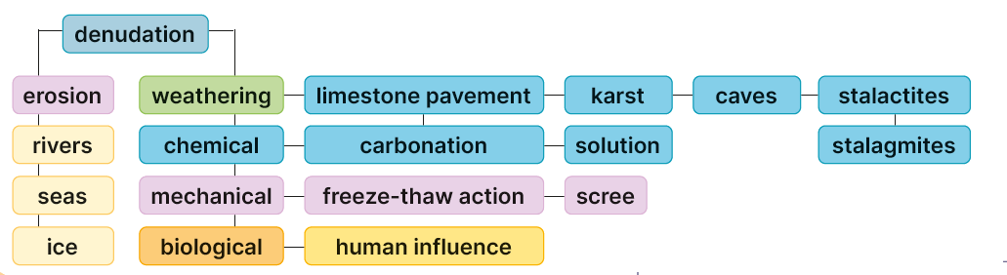
Keyword connections

Slide 4
DEFINITIONS;
Denudation; The stripping bare of the earth’s surface by the processes of weathering and erosion.
Erosion; The break up and carrying away of rock by the agents of erosion.
Agents of erosion; Wind, Ice, Sea and Rivers.
Weathering; The break up of rock in situ.

Slide 5
7.1 Explain the differences between denudation, weathering and erosion.
Denudation means weathering and erosion.
Weathering is a process that causes rocks to be broken into smaller pieces over time. Weathering happens in situ – in the place where a rock happens to be.
Erosion is a process that breaks rocks into smaller piece by transporting sediments by agents of erosion: rivers, sea, glaciers and wind.
Go to Section 7.1 on page 26 of your Skills Book.

Slide 6
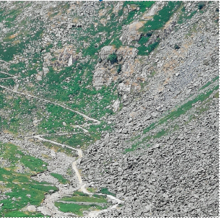
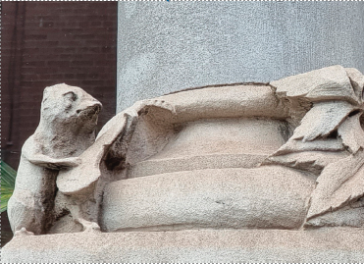
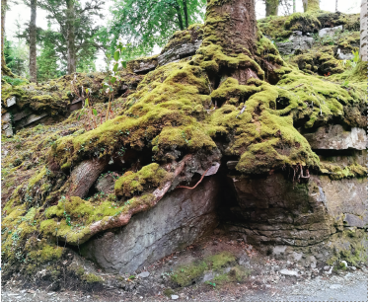
There are three types of weathering working in a landscape.
Mechanical weathering involves.
Chemical weathering involves.
Biological weathering occurs when. For example, people cause the release of carbon dioxide into the atmosphere. This can lead to the formation of acid rain and the greater chemical weathering of rocks such as limestone.
7.2 Identify the three types of weathering.
Mechanical | Chemical | Biological
Rock is physically broken apart. | Rock is dissolved gradually over time. | Rock is broken apart by burrowing animals or by plants. Human activity can also contribute to weathering.

Slide 7
7.2 Identify the three types of weathering.
Go to Section 7.2 on page 26 of your Skills Book.

Slide 8
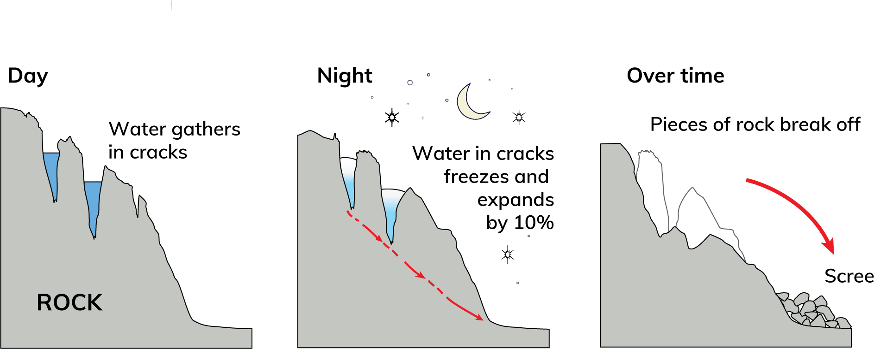
7.3 Explain how mechanical weathering affects the landscape.
1. Rainwater gathers in the joints (cracks) in rocks. Whenever the temperature falls below freezing point, this water freezes and expands by about 10 per cent.
2. This places pressure on the joints in the rock, causing them to widen slightly.
3. When the water thaws, it lies deeper in the joints. The next time the water freezes, the joints widen even more.
4. Eventually, the rock breaks and collapses into smaller pieces of rock called scree. Scree can be found on the sides of many mountains, such as the Great Sugarloaf in Co. Wicklow.

Slide 9

7.1, 7.2 and 7.3
1. What is denudation?
2. Give a definition of mechanical weathering.
3. How does chemical weathering change rock?
4. Where does freeze-thaw action happen most often?
5. Give one example of how humans can contribute to weathering.

Slide 10
7.1, 7.2 and 7.3
Higher-order questions 1
1. How many human activities can you think of that contribute to weathering?
2. Can freeze-thaw action happen in summer?
3. Are some rocks more easily weathered than others?

Slide 11
7.1, 7.2 and 7.3
Go to Section 7.3 on page 27 of your Skills Book.

Slide 12
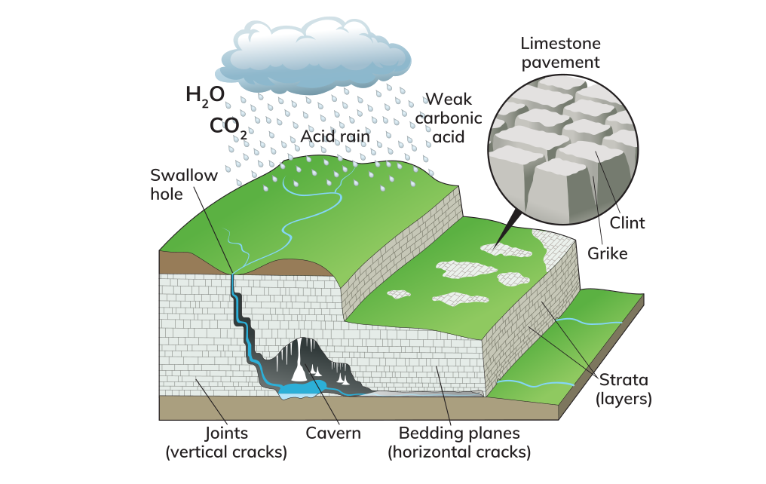
7.4 Explain how chemical weathering affects the landscape.

Slide 13
7.4 Explain how chemical weathering affects the landscape.
Characteristics of limestone
Soft sedimentary rock.
Contains fossils
Calcium carbonate
Built up in layers of rock called ‘strata’.
Strata separated bedding planes
Each layer also has vertical cracks called joints.
Bedding planes and joints make limestone permeable – water can pass through it.
Acid rain reacts with calcium carbonate and dissolves it.

Slide 14
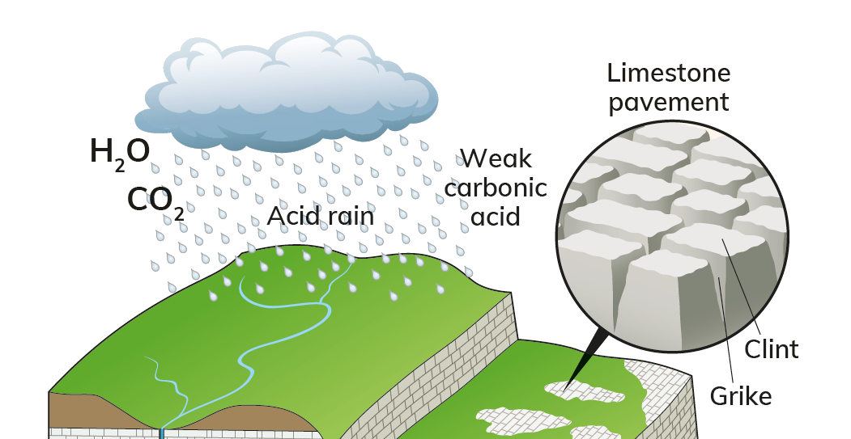
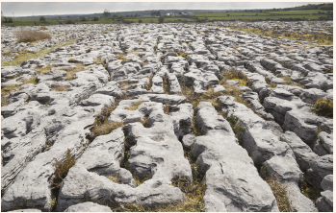
7.4 Explain how chemical weathering affects the landscape.
Chemical Weathering: Carbonation
Carbonation is the process of rock being dissolved by a weak carbonic acid.
Rain passes through the atmosphere
Combines with carbon dioxide
Produces a weak carbonic acid – acid rain forms.
Acid rain falls on limestone
Dissolves the weaker parts of the limestone surface
Deepens and forms grikes.
The slabs are called clints.
The pattern of clints and grikes makes up limestone pavement.

Slide 15
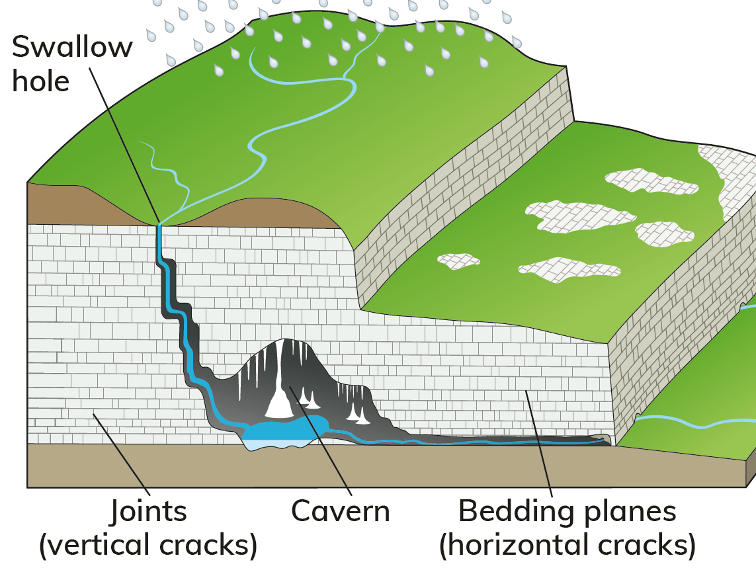
7.4 Explain how chemical weathering affects the landscape.
Chemical Weathering: Carbonation
Limestone is easily eroded by the weak acids found in river water.
A river will erode down through the limestone.
This creates a swallow hole.
As water moves through the joints and bedding plane of the permeable limestone, it can form underground features.

Slide 16

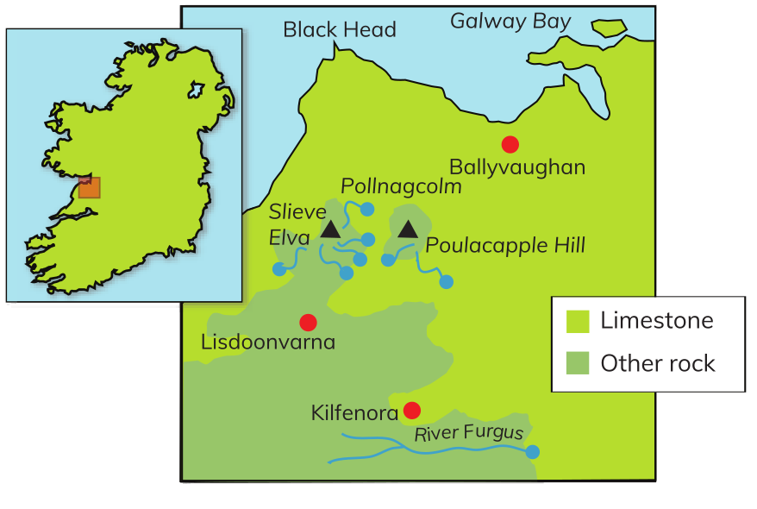
7.4 Explain how chemical weathering affects the landscape.
The Burren, Co. Clare
A large area of exposed limestone, or karst
The name is from the Irish word for ‘rocky place’.
Limestone 365 million years ago
Soil removed by glacial erosion
This left the rock bare and exposed to the weather.
Famous for its landscape and its ﬂora and fauna
Arctic-alpine plants grow alongside Mediterranean plants
Spring gentians, early-purple orchid and mountain avens
Feral goats, stoat, pine martens and Irish hare, rare insects and butterﬂies.

Slide 17
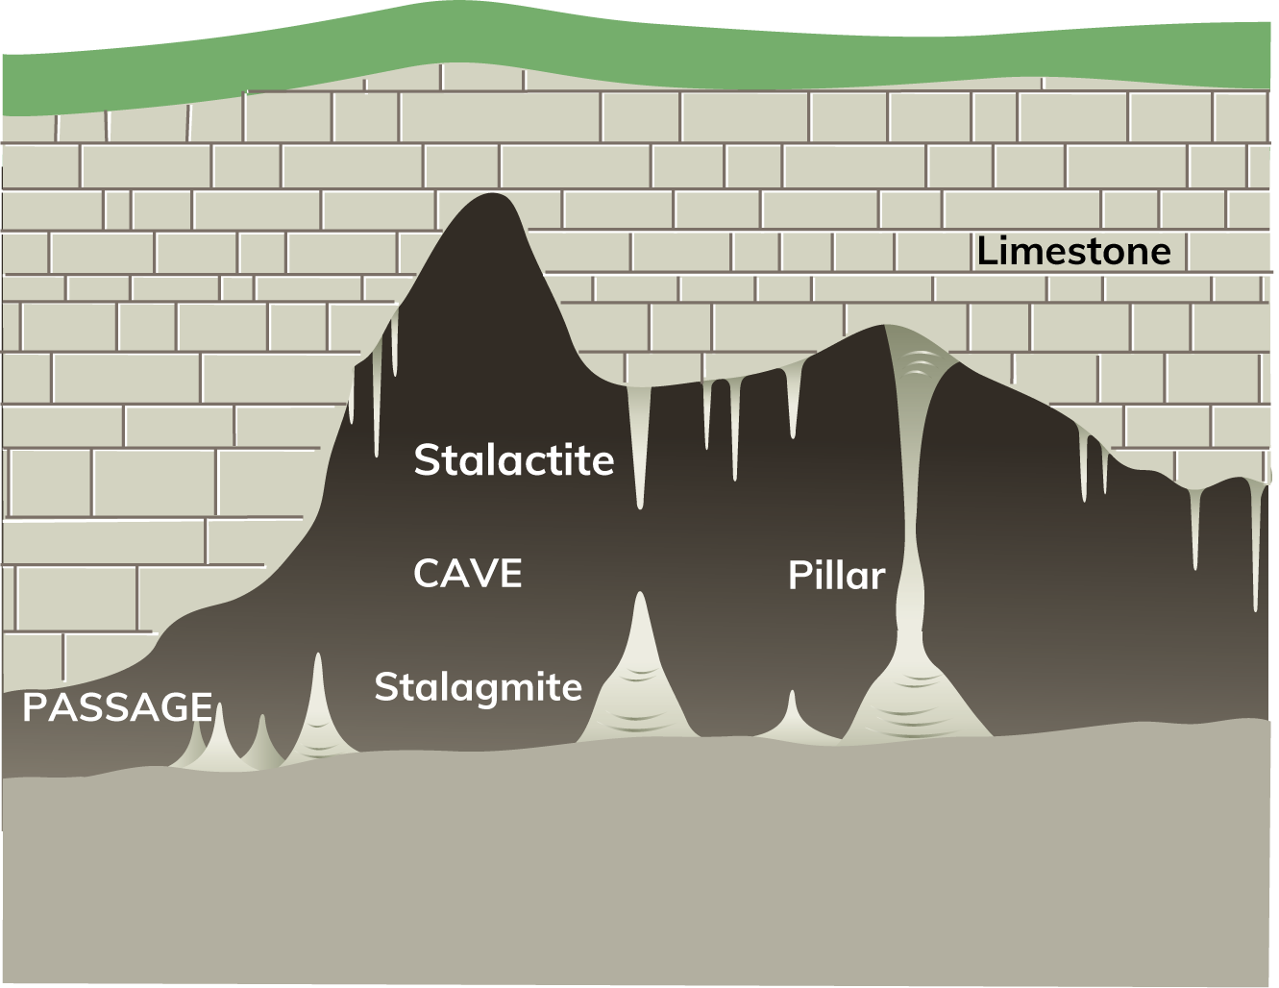
7.4 Explain how chemical weathering affects the landscape.
The Burren, Co. Clare
Underground features

Slide 18
7.4 Explain how chemical weathering affects the landscape.
The Burren, Co. Clare
Underground features
When a river flows underground, the water dissolves the limestone by carbonation.
Causes long tunnels, called passages, to form.
Passages may become enlarged to form caves or caverns.

Slide 19
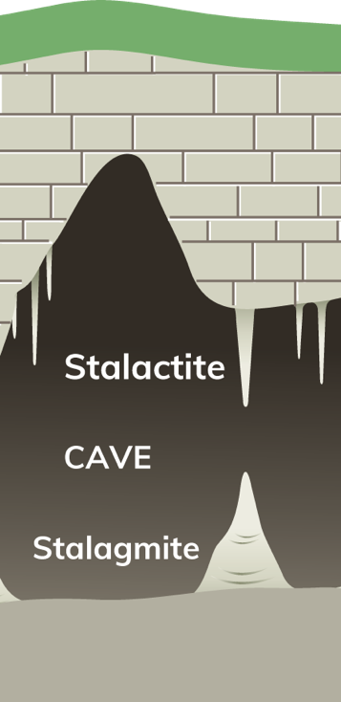
7.4 Explain how chemical weathering affects the landscape.
Underground features
Stalactites
Slender columns of calcite that hang from the ceiling of a cave
Water containing dissolved limestone (calcium carbonate) seeps through to a cave or cavern
Drops of calcium carbonate hang from the ceiling
Water evaporates from these drops and leaves a tiny spot of calcite, which hardens
Over time, these deposits of calcite build up to form a column-shape hanging from the ceiling of the cave – the stalactite.
If they develop along a crack in the ceiling, they become a long sheet of calcite called a curtain.

Slide 20
7.4 Explain how chemical weathering affects the landscape.
Underground features
Stalagmites
Thick columns of calcite that build up on the floor of a cave
Directly below a stalactite
Form when drops of water containing dissolved limestone fall onto the cave floor
Water evaporates from the drops and leaves a small deposit of calcite. These build up over time to form a thick column on the floor.
If a stalactite and a stalagmite meet, they form a pillar.
4. If they develop along a crack in the ceiling, they become a long sheet of calcite called a curtain.

Slide 21

7.4 Explain how chemical weathering affects the landscape.
1. What is carbonic acid?
2. Which hangs from the ceiling of a cave – stalactites or stalagmites?
3. What is the mineral in limestone that is dissolved by acid rain?
4. What are clints and grikes?
5. What does the term ‘karst’ mean?

Slide 22
7.4 Explain how chemical weathering affects the landscape.
Higher-order questions 2
1. How deep do you think grikes can become? Explain your answer.
2. What happens if a limestone cave collapses?
3. Can human activity increase the amount of chemical weathering? Explain your answer.

Slide 23
7.4 Explain how chemical weathering affects the landscape.
Go to Section 7.4 on page 27 of your Skills Book.

Slide 24
Assess your progress
Go to page 29 of your Skills Book and assess your progress.
7.1 Explain the differences between denudation, weathering and erosion.
7.2 Identify the three types of weathering.
7.3 Explain how mechanical weathering affects the landscape.
7.4 Explain how chemical weathering affects the landscape.
Identify any gaps in your learning. Use the Rapid Revision on page 77 of your Textbook to jog your memory.

